Slide 1
Hungry Go THERE
When you don’t know what to eat, where to eat, and how to get there.

Slide 2

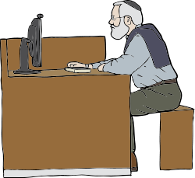
User Story #1
Okay can! But we’re very bored of the food in the canteen already.
WHERE CAN EAT?
It’s finally Lunchtime!
Guys, want to go have lunch together?

Slide 3
Hungry Go There!
Where Can Eat?
Halfway Eat Where

